Slide 1
Presentation of a database management system to handle instruments and measurements
30. September 2021 | Forschungszentrum Jülich GmbH
Institute of Energy and Climate Research – IEK 8 (Troposhere)
M. Kennert, U. Bundke, A. Gomes, C. Mahnke, S. Rohs, A. Petzold

Slide 2
outline
System Overview
Database
Workflow
01
Our Mission
05
Create an Instrument
09
Overview
02
IAGOS Workflow
06
Create a Calibration
10
Import your Data
03
Our Solution
07
Deploy an Instrument
11
QA/QC Framework
04
System Setup
08
Import a Time Series
12
Export your Data
30. September 2021 │ Slide 1 of 19
System Overview
Database
Workflow

Slide 3
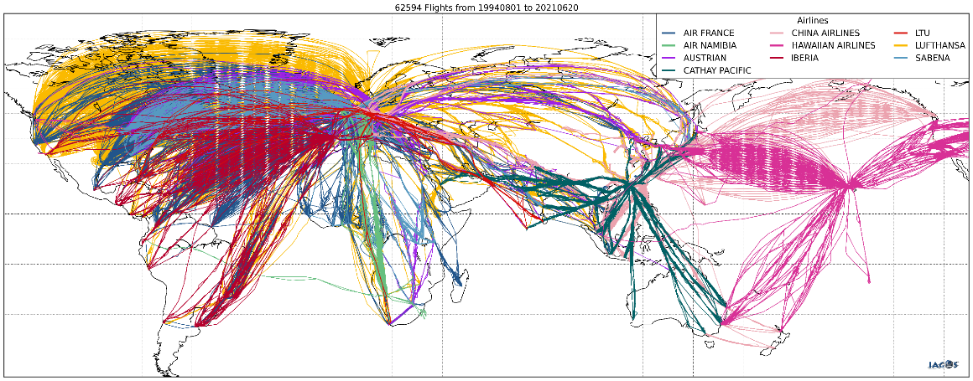
Our mission
IAGOS-CORE
O₃
H₂O
CO₂
CO
CH₄
NO_{x}
clouds
aerosol
28 June 2021: 62617 flights in database
European Research Infrastructure since 2014 (historical MOZAIC: 1994 - 2014)
Regular in-situ monitoring of essential climate variables H₂O, O₃, CO, NO_{x}, CO₂, CH₄, aerosols, clouds
7 long-haul aircraft (IAGOS-CORE) + 1 Flying Laboratory (IAGOS-CARIBIC)
Provision of data in near real time for Copernicus and other service
30. September 2021 │ Slide 2 of 19
System Overview
Database
Workflow

Slide 4
IAGOS WORKFLOW
IAGOS data products
Research Institutions
calibration data
meta data
IAGOS Data Centre
hosted by AERIS
in Toulouse, France
near real time
data transfer
deployment maintenance
data
30. September 2021 │ Slide 3 of 19
System Overview
Database
Workflow

Slide 5
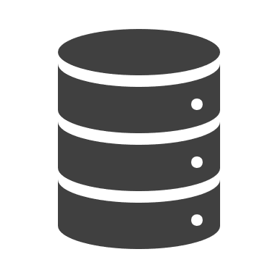
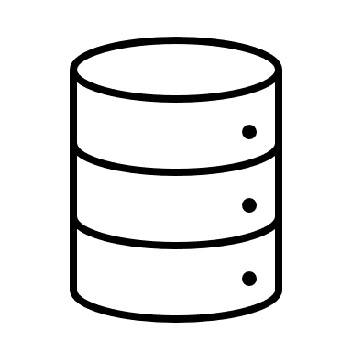
Our solution
External
FZJ Data Portal
Users
System
Storage
Web Browser or REST-API
Database
Volume
Instruments
Deployments
Time Series
Raw Files
Reports
Scientists
Technicians
PIs
System properties
Realized with Docker
Application is implemented with Python and Django
Supports common databases (e.g., PostgreSQL )
Interaction via Web Browser or REST-API
Includes a configurable Workflow system
Provides algorithms for QA/QC checks
Provides JupyterHub-Service
Adaptable to other projects
Systems
Machine-to-Machine
Communication
(FTP, REST, etc.)
External A
External B
External C
30. September 2021 │ Slide 4 of 19
System Overview
Database
Workflow

Slide 6
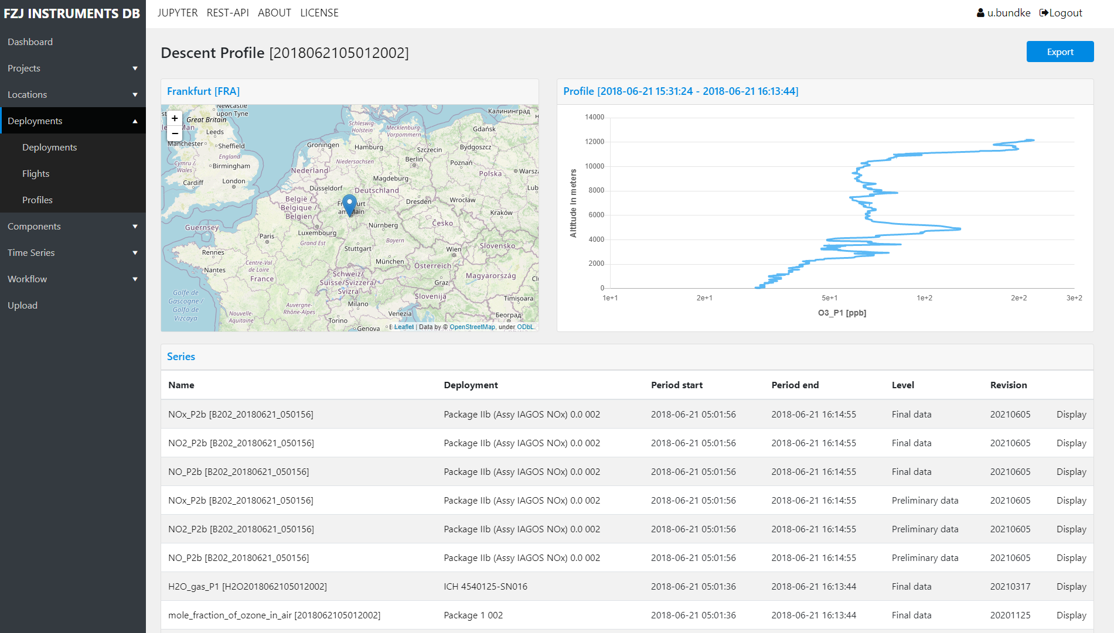
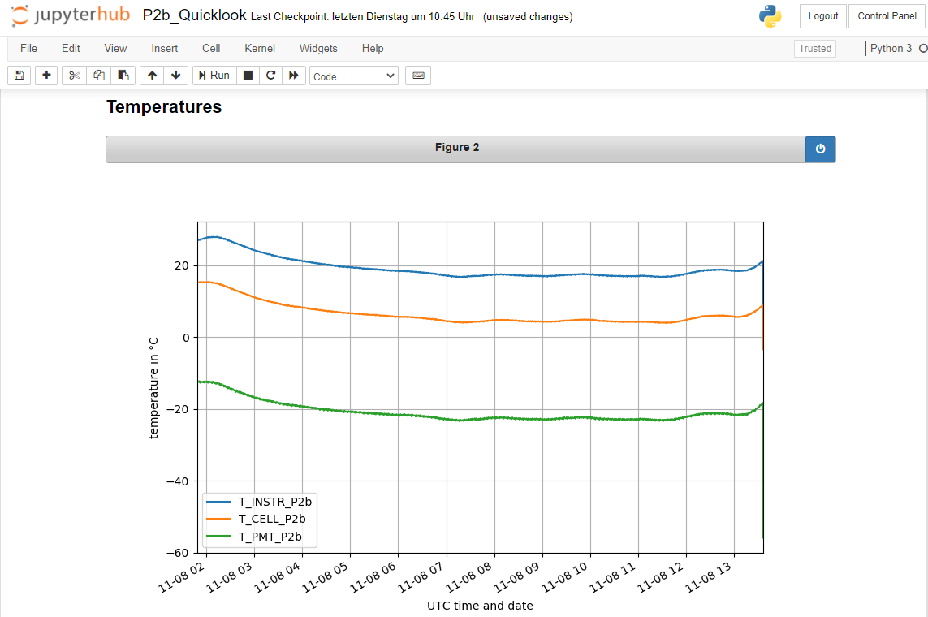
User interaction
FZJ Data Portal
JupyterHub
+
Simple and intuitive web interface to manage the data
Use the REST-API to produce customized quicklooks
30. September 2021 │ Slide 5 of 19
System Overview
Database
Workflow

Slide 7
Advantages of using the portal
Centralized
Traceable
Compatibility
Problem
Groups usually have the data stored at different locations. For example, files are stored in separate folders or systems
Problem
It‘s often too difficult to overview the whole measurement process
It‘s often not clear which data was used for calculations
Problem
Groups usually have the data stored in different structures and formats
It is hard to share the data since the structures are not compatible
Advantage
Portal will centralize the data and make it accessible
Portal will also provide filters to search for specific data
Advantage
Stores every information (deployment, setup, calibrations)
Stores the relation between the series to make data reconstructable
Advantage
All groups have the same database structure and the same models
Data and implemented components can be easily shared
30. September 2021 │ Slide 6 of 19
System Overview
Database
Workflow

Slide 8
Setup requirements
Conda is an open-source package management system for Python
Allows you to create multiple Virtual Environments to avoid dependency conflicts
Git is a free open source distrubuted version control system
We use Git to manage the code and to make it accessible
make
Docker is an open platform for developing, shipping, and running applications
Allows you to deploy your system easily and ensures that your system is easy to scale up
Make is a build automation tool
We use Make to avoid writing complicated shell commands and to build automated processes
30. September 2021 │ Slide 7 of 19
System Overview
Database
Workflow

Slide 9
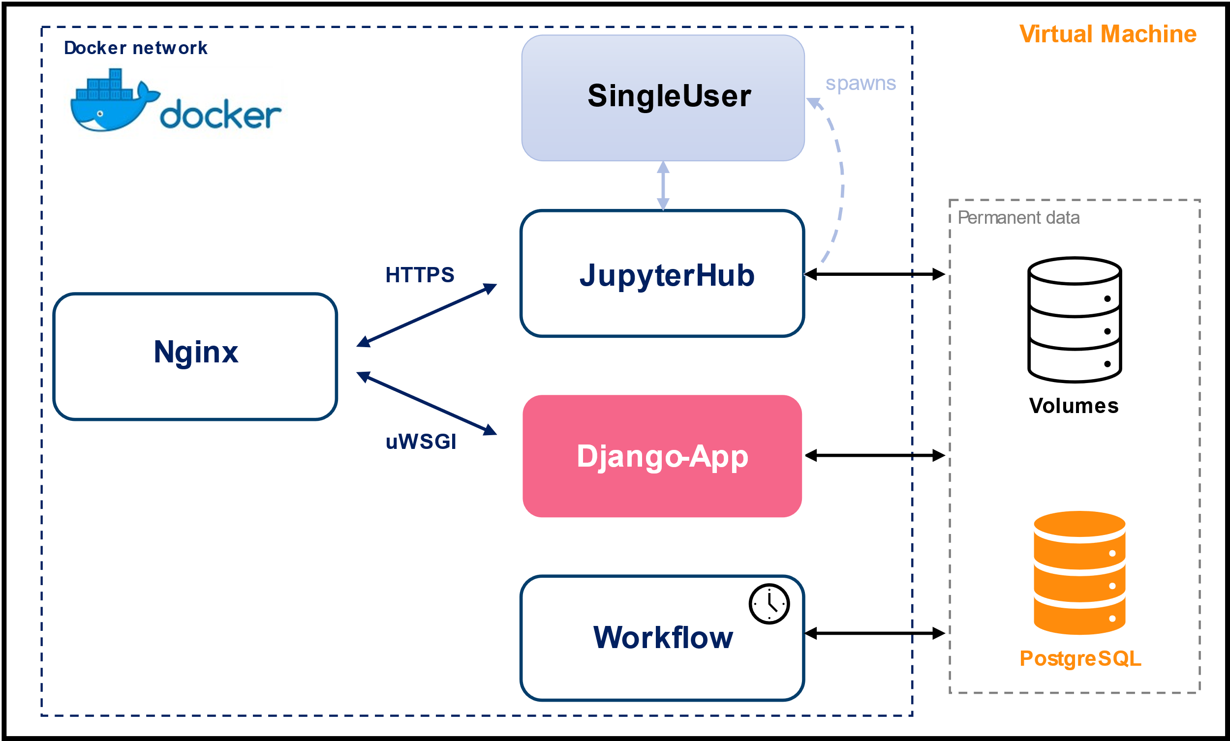
System Setup
setup instructions
Production System
Create a Virtual Environment
Download code from repository
Install the needed Python packages
Run the web application (Django)
Run the docker system (optional)
Configure the Production System
30. September 2021 │ Slide 8 of 19
System Overview
Database
Workflow

Slide 10
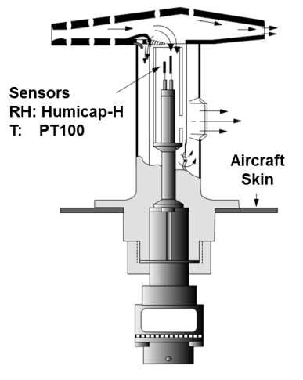
Create an instrument
INSTRUMENT
ABSTRACT STRUCTURE
STEPS TO CREATE AN INSTRUMENT
ICH Unit
HumiCap
RH Sensor
PT100 Sensor
Transmitterbox
Create component classes
Create component types
Metadata
Assign parameters
Create Components
Instance
Build the Instrument
IAGOS CAPACITIVE HYGROMETER
30. September 2021 │ Slide 9 of 19
System Overview
Database
Workflow

Slide 11
Create an instrument
INSTRUMENT
ABSTRACT STRUCTURE
STEPS TO CREATE AN INSTRUMENT
Unit
Unit
Sensor
Sensor
CPU
Create component classes
Create component types
Metadata
Assign parameters
Create Components
Instance
Build the Instrument
IAGOS CAPACITIVE HYGROMETER
30. September 2021 │ Slide 9 of 19
System Overview
Database
Workflow

Slide 12
Create an instrument
INSTRUMENT
ABSTRACT STRUCTURE
STEPS TO CREATE AN INSTRUMENT
ICH Unit
HumiCap
RH Sensor
PT100 Sensor
Transmitterbox
Create component classes
Create component types
Metadata
Assign parameters
Create Components
Instance
Build the Instrument
IAGOS CAPACITIVE HYGROMETER
30. September 2021 │ Slide 9 of 19
System Overview
Database
Workflow

Slide 13
Create an instrument
INSTRUMENT
ABSTRACT STRUCTURE
STEPS TO CREATE AN INSTRUMENT
H2O
Relative humidity
Temperature
Create component classes
Create component types
Metadata
Assign parameters
Create Components
Instance
Build the Instrument
IAGOS CAPACITIVE HYGROMETER
30. September 2021 │ Slide 9 of 19
System Overview
Database
Workflow

Slide 14
Create an instrument
INSTRUMENT
ABSTRACT STRUCTURE
STEPS TO CREATE AN INSTRUMENT
SN-MKX27
SN-AGY34
SN-UBZ55
SN-APQ56
SN-CMP32
Create component classes
Create component types
Metadata
Assign parameters
Create Components
Instance
Build the Instrument
IAGOS CAPACITIVE HYGROMETER
30. September 2021 │ Slide 9 of 19
System Overview
Database
Workflow

Slide 15
Create an instrument
INSTRUMENT
ABSTRACT STRUCTURE
STEPS TO CREATE AN INSTRUMENT
ICH Unit
HumiCap
RH Sensor
PT100 Sensor
Transmitterbox
Create component classes
Create component types
Metadata
Assign parameters
Create Components
Instance
Build the Instrument
IAGOS CAPACITIVE HYGROMETER
30. September 2021 │ Slide 9 of 19
System Overview
Database
Workflow

Slide 16
Create a Calibration
INSTRUMENT
SAMPLE CALIBRATION
STEPS TO CREATE A CALIBRATION
1. Define the parameter
Create a component
Name | Long Name | Unit | CF
A | - | ppm | -
B | - | ppm | -
Create parameters
2. Define the calibrations
Create calibrations
Parameter | Pre-Cal | Post-Cal | Component
A | 42 | 40.5 | ICH Unit
B | 666 | 642 | ICH Unit
Timestamp | 2019-12-24 | 2022-01-06
Assign calibration parameters
IAGOS CAPACITIVE HYGROMETER
30. September 2021 │ Slide 10 of 19
System Overview
Database
Workflow

Slide 17
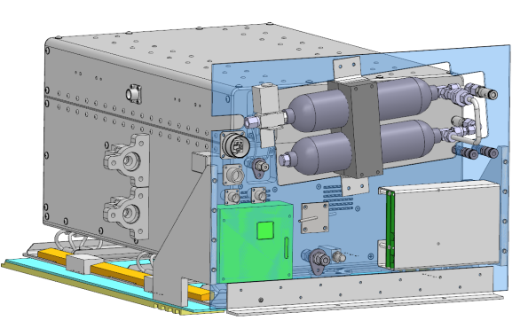
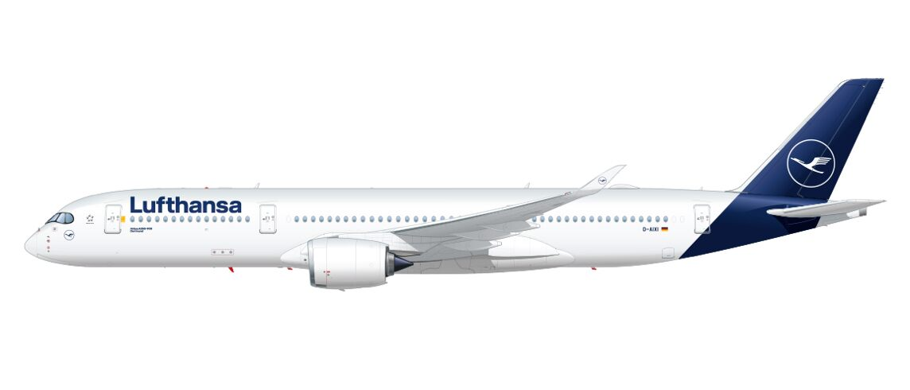
Deploy an instrument
PROPERTIES
STEPS TO CREATE A DEPLOYMENT
Instrument Details
Location (Aircraft or Station)
Installation Timestamp
Removal Timestamp
Project Details
Create a project
Create an instrument
Create a location
Deploy your instrument
30. September 2021 │ Slide 11 of 19
System Overview
Database
Workflow

Slide 18
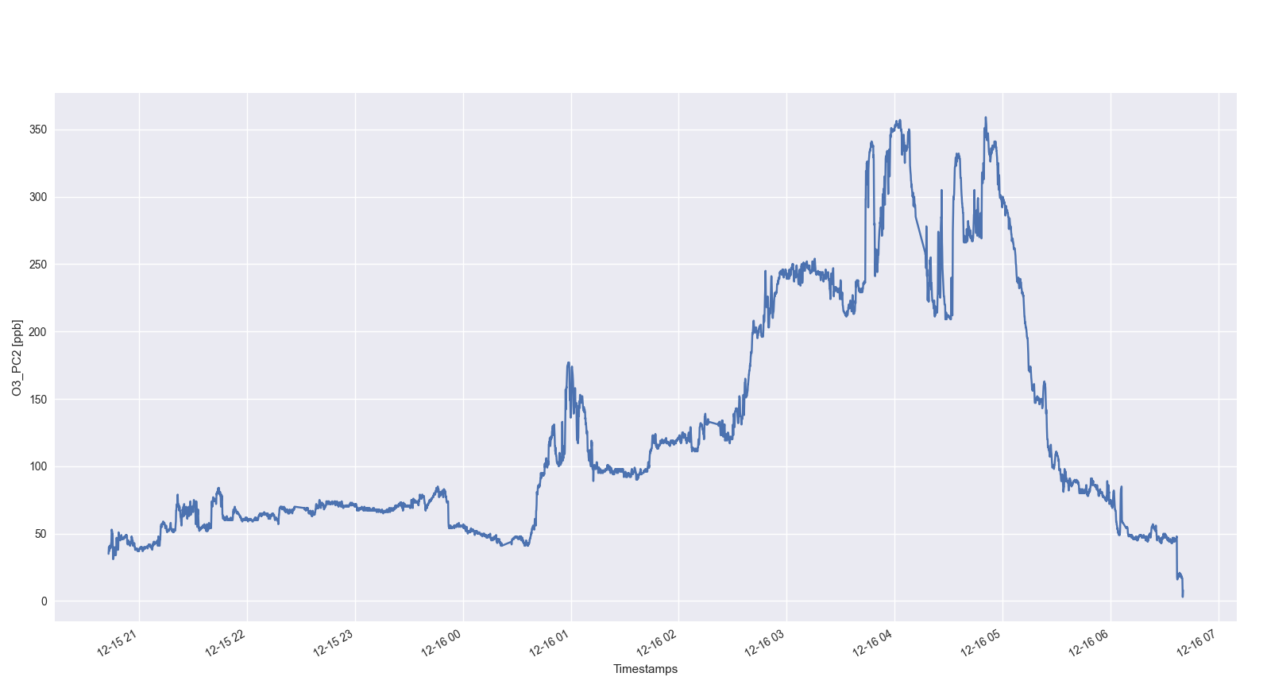
Import a time series
TIME SERIES
STEPS TO CREATE A SERIES
Create data levels
Create data validities
Create the metadata of the
time series
Import data points
Metadata
Levels, validities and revision
Instrument information
Deployment information
Relations
Calibrations
Calibration Functions
Time Series
Create relations
30. September 2021 │ Slide 12 of 19
System Overview
Database
Workflow

Slide 19
Workflow – overview
Scheduler
Scheduler
User
hourly, daily, weekly
hourly, daily, weekly
Process
Process
Queue
Queue
T1
T2
T3
T2
T3
Job 1
Job 2
Job 1
Job 1
Metadata
Series
Waiting
Running
Metadata
Metadata
Series
Job 1 depends on Job 2
Job 1 depends on Job 2
Series
Series
QA/QC Tests
Job 2
Job 2
Series
Series
30. September 2021 │ Slide 13 of 19
System Overview
Database
Workflow

Slide 20
Task – overview
Task manager
External Systems
Task
Transfer Handler
Requests the data of the given source
Import Manager
Parses and imports the data and process it afterwards
Transfer type
Authentication
Reader
Importer
Reprocess
QA/QC Checks [In progress]
Checks the data. Flags it and creates a report for the PI
The PI checks the plausibility of the data. If the data is acceptable, the PI will release the data
External Systems
Transfer Handler
Sends the data to the given destination
Export Manager
Writes the data into a specific format and exports the written data
Transfer type
Authentication
Writer
Exporter
30. September 2021 │ Slide 14 of 19
System Overview
Database
Workflow

Slide 21
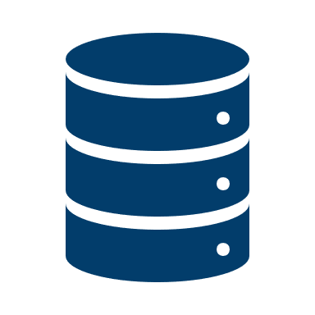
Import your data
Sources
Import Process
STEPS TO IMPORT YOUR DATA
External A
Transfer
Interprete Data
Implement a Reader
(Reader)
External B
Transfer
Process Data
Register your Reader
(Importer)
External C
Import Data
Transfer
(Importer)
Implement an Importer
External D
Perform QA/QC tests
Register your Importer
Transfer
30. September 2021 │ Slide 15 of 19
System Overview
Database
Workflow

Slide 22
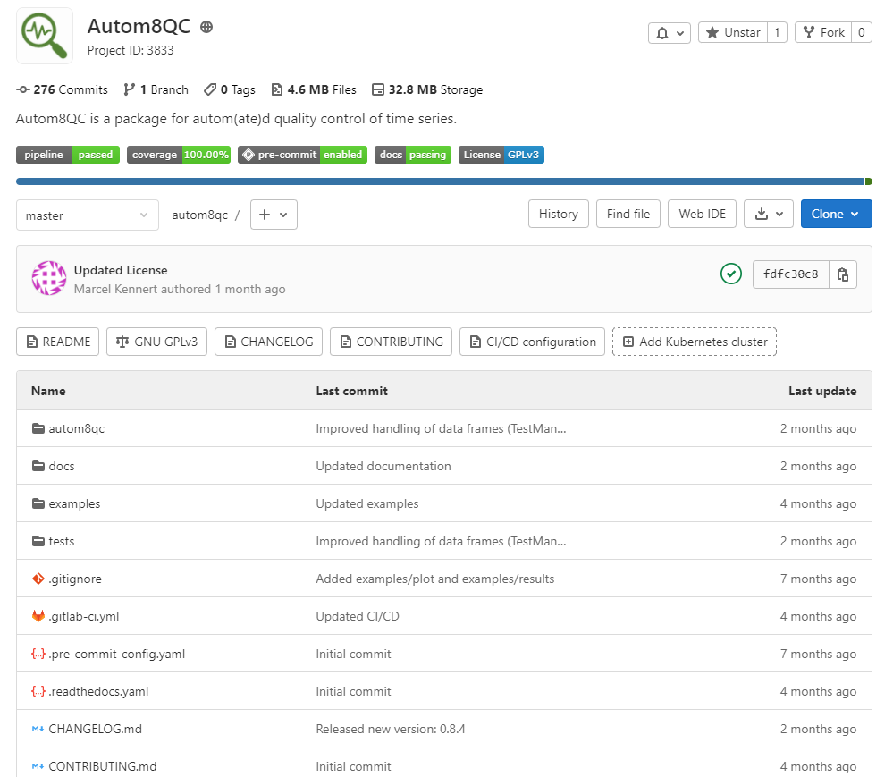
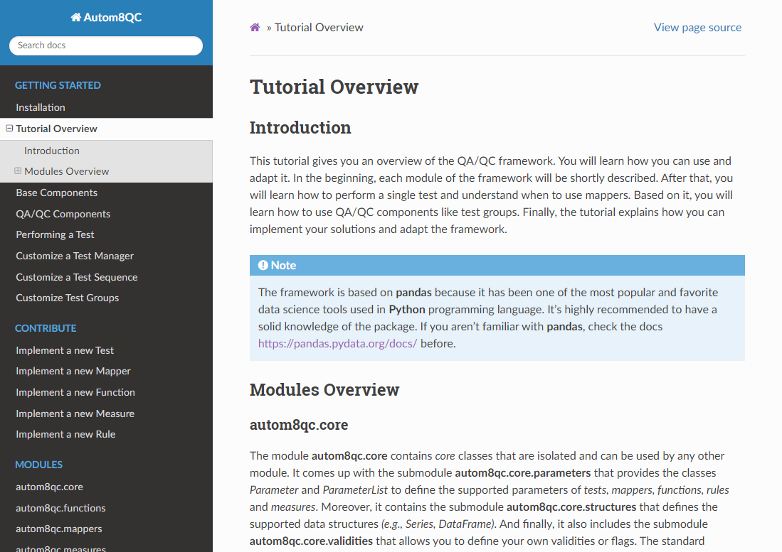
QA/QC Framework – Autom8qc
OVERVIEW
OPEN SOURCE PROJECT
Developed and used by the DE community
Application of probablistic approaches
Adaptable to different environments
Provides advanced QA/QC tests
TUTORIAL
https://autom8qc.readthedocs.io/en/latest
https://jugit.fz-juelich.de/m.kennert/autom8qc
30. September 2021 │ Slide 16 of 19
System Overview
Database
Workflow

Slide 23
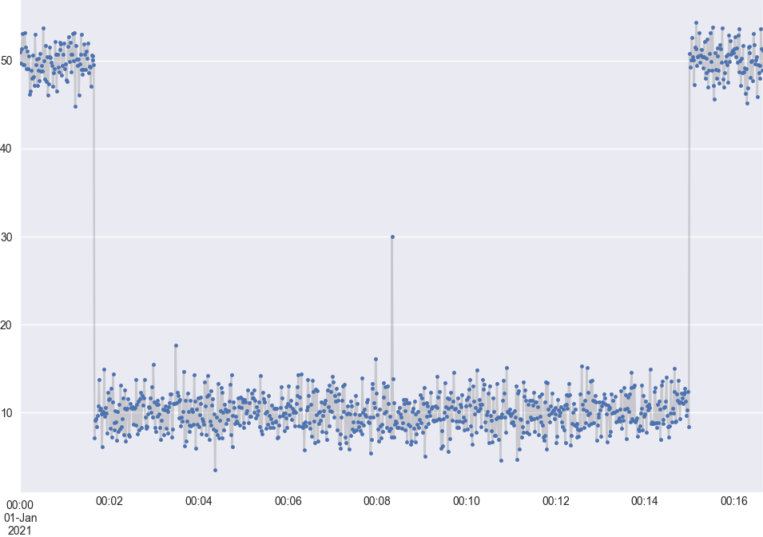
QA/QC Framework – basic example
Execution Pipeline
Visualization
Perform Time Range Test
QAQCTest
Before departure
After arrival
Perform Global Minimum Test
QAQCTest
Perform Outlier Test
QAQCTest
Outlier
Merge results
BaseMeasure
Perform Rule
BaseRule
Too low values
Map probabilities to validities
BaseMapper
30. September 2021 │ Slide 17 of 19
System Overview
Database
Workflow

Slide 24
QA/QC Framework – basic example
Execution Pipeline
Visualization
Perform Time Range Test
QAQCTest
Perform Global Minimum Test
QAQCTest
Perform Outlier Test
QAQCTest
Merge results
BaseMeasure
Perform Rule
BaseRule
Map probabilities to validities
BaseMapper
30. September 2021 │ Slide 17 of 19
System Overview
Database
Workflow

Slide 25
QA/QC Framework – basic example
Execution Pipeline
Visualization
Perform Time Range Test
QAQCTest
Before departure
After arrival
Perform Global Minimum Test
QAQCTest
Perform Outlier Test
QAQCTest
Merge results
BaseMeasure
Perform Rule
BaseRule
Map probabilities to validities
BaseMapper
30. September 2021 │ Slide 17 of 19
System Overview
Database
Workflow

Slide 26
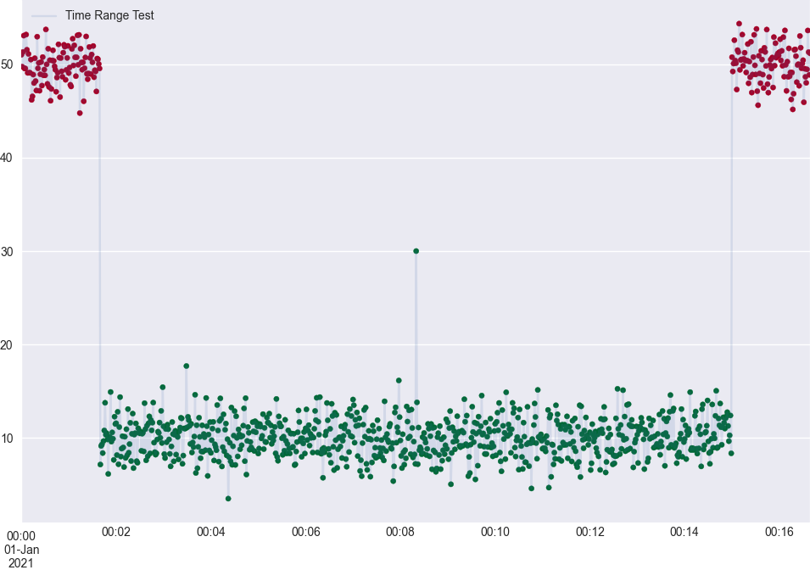
QA/QC Framework – basic example
Execution Pipeline
Visualization
Perform Time Range Test
QAQCTest
Perform Global Minimum Test
QAQCTest
Perform Outlier Test
QAQCTest
Merge results
BaseMeasure
Perform Rule
BaseRule
Map probabilities to validities
BaseMapper
30. September 2021 │ Slide 17 of 19
System Overview
Database
Workflow

Slide 27
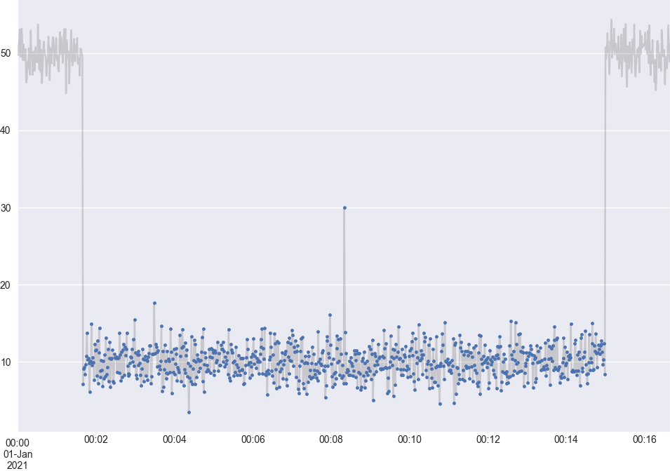
QA/QC Framework – basic example
Execution Pipeline
Visualization
Perform Time Range Test
QAQCTest
Perform Global Minimum Test
QAQCTest
Perform Outlier Test
QAQCTest
Merge results
BaseMeasure
Perform Rule
BaseRule
Map probabilities to validities
BaseMapper
Remove failed data points
30. September 2021 │ Slide 17 of 19
System Overview
Database
Workflow

Slide 28
QA/QC Framework – basic example
Execution Pipeline
Visualization
Perform Time Range Test
QAQCTest
Perform Global Minimum Test
QAQCTest
Perform Outlier Test
QAQCTest
Merge results
BaseMeasure
Perform Rule
BaseRule
Too low values
Map probabilities to validities
BaseMapper
30. September 2021 │ Slide 17 of 19
System Overview
Database
Workflow

Slide 29
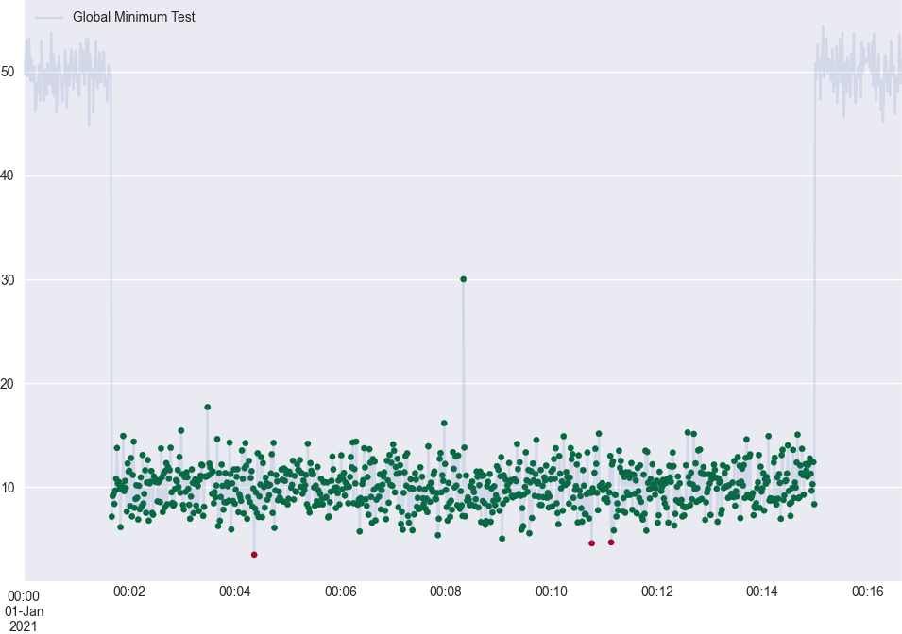
QA/QC Framework – basic example
Execution Pipeline
Visualization
Perform Time Range Test
QAQCTest
Perform Global Minimum Test
QAQCTest
Perform Outlier Test
QAQCTest
Merge results
BaseMeasure
Perform Rule
BaseRule
Map probabilities to validities
BaseMapper
30. September 2021 │ Slide 17 of 19
System Overview
Database
Workflow

Slide 30
QA/QC Framework – basic example
Execution Pipeline
Visualization
Perform Time Range Test
QAQCTest
Perform Global Minimum Test
QAQCTest
Perform Outlier Test
QAQCTest
Merge results
BaseMeasure
Perform Rule
BaseRule
Map probabilities to validities
BaseMapper
Remove failed data points
30. September 2021 │ Slide 17 of 19
System Overview
Database
Workflow

Slide 31
QA/QC Framework – basic example
Execution Pipeline
Visualization
Perform Time Range Test
QAQCTest
Perform Global Minimum Test
QAQCTest
Perform Outlier Test
QAQCTest
Outlier
Merge results
BaseMeasure
Perform Rule
BaseRule
Map probabilities to validities
BaseMapper
30. September 2021 │ Slide 17 of 19
System Overview
Database
Workflow

Slide 32
QA/QC Framework – basic example
Execution Pipeline
Visualization
Perform Time Range Test
QAQCTest
Perform Global Minimum Test
QAQCTest
Perform Outlier Test
QAQCTest
Merge results
BaseMeasure
Perform Rule
BaseRule
Map probabilities to validities
BaseMapper
30. September 2021 │ Slide 17 of 19
System Overview
Database
Workflow

Slide 33
QA/QC Framework – basic example
Execution Pipeline
Visualization
Perform Time Range Test
QAQCTest
Perform Global Minimum Test
QAQCTest
Perform Outlier Test
QAQCTest
Merge results
BaseMeasure
Perform Rule
BaseRule
Map probabilities to validities
BaseMapper
Remove failed data points
30. September 2021 │ Slide 17 of 19
System Overview
Database
Workflow

Slide 34
QA/QC Framework – basic example
Execution Pipeline
Visualization
Perform Time Range Test
QAQCTest
Perform Global Minimum Test
QAQCTest
Perform Outlier Test
QAQCTest
Merge results
BaseMeasure
Perform Rule
BaseRule
Map probabilities to validities
BaseMapper
30. September 2021 │ Slide 17 of 19
System Overview
Database
Workflow

Slide 35
QA/QC Framework – basic example
Execution Pipeline
Visualization
Perform Time Range Test
QAQCTest
Perform Global Minimum Test
QAQCTest
Perform Outlier Test
QAQCTest
Merge results
BaseMeasure
Perform Rule
BaseRule
Map probabilities to validities
BaseMapper
If more than 40% of the data points have a probability
lower than 10% then set all probabilities to 0%
30. September 2021 │ Slide 17 of 19
System Overview
Database
Workflow

Slide 36
QA/QC Framework – basic example
Execution Pipeline
Visualization
Perform Time Range Test
QAQCTest
Data Points | Results | Test
2021-01-01 00:00:00 | Invalid | Time Range Test
2021-01-01 00:00:01 | Invalid | Time Range Test
2021-01-01 00:00:02 | Invalid | Time Range Test
… | … | …
2021-01-01 00:01:41 | Good | -
2021-01-01 00:01:42 | Good | -
… | … | …
2021-01-01 00:04:22 | Invalid | Global Minimum Test
… | … | …
2021-01-01 00:08:20 | Invalid | Outlier Test
… | … | …
2021-01-01 00:10:46 | Invalid | Global Minimum Test
2021-01-01 00:11:08 | Invalid | Global Minimum Test
… | … | …
2021-01-01 00:00:02 | Invalid | Time Range Test
Perform Global Minimum Test
QAQCTest
Perform Outlier Test
QAQCTest
Merge results
BaseMeasure
Perform Rule
BaseRule
Map probabilities to validities
BaseMapper
30. September 2021 │ Slide 17 of 19
System Overview
Database
Workflow

Slide 37
Export your data
Destination
STEPS TO EXPORT YOUR DATA
Export Process
External A
Transfer
Implement an Exporter
Read Data
(Exporter)
External B
Transfer
Register your Exporter
Prepare Data
(Exporter)
External C
Transfer
Implement a Writer
Write Data
(Writer)
External D
Register your Writer
Transfer
30. September 2021 │ Slide 18 of 19
System Overview
Database
Workflow

Slide 38
References
Repository – FZJ Instruments Database https://jugit.fz-juelich.de/m.kennert/instruments-db
Online Documentation – FZJ Instruments Database https://instruments-database.readthedocs.io/en/latest/index.html
FZJ Data Portal (FZJ Intranet) http://zam10200.zam.kfa-juelich.de/
Repository – QA/QC Framework https://jugit.fz-juelich.de/m.kennert/autom8qc
Online Documentation – QA/QC Framework https://autom8qc.readthedocs.io/en/latest/index.html
30. September 2021 │ Slide 19 of 19
System Overview
Database
Workflow

